Slide 2
Faith in the God of the Impossible

Slide 3
Faith in the God of the Impossible
Romans 4:17: As it is written: “I have made you a father of many nations.” He is our father in the sight of God, in whom he believed—the God who gives life to the dead and calls into being things that were not.

Slide 4
The God Who Gives Life to the Dead.

Slide 5
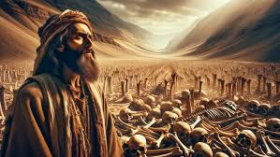

Slide 6
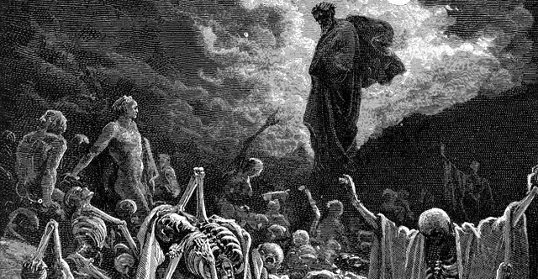

Slide 7
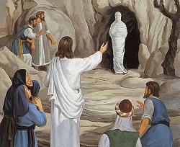
“Lazarus, come forth!”

Slide 8
“Lazarus, come forth!”
“My God gives life to the dead. There is nothing too far gone for Him!”

Slide 9
The God Who Calls Things into Being

Slide 10
The God Who Calls Things into Being
“”Let there be light,”

Slide 11
“You will be a father of many nations.”

Slide 12
Faith That Believes Beyond the Natural

Slide 13
Romans 4:20 He did not waver through unbelief regarding the promise of God, but was strengthened in his faith and gave glory to God.

Slide 14
100 years old,
Barren,
Romans 4:20 He did not waver through unbelief regarding the promise of God, but was strengthened in his faith and gave glory to God.

Slide 15
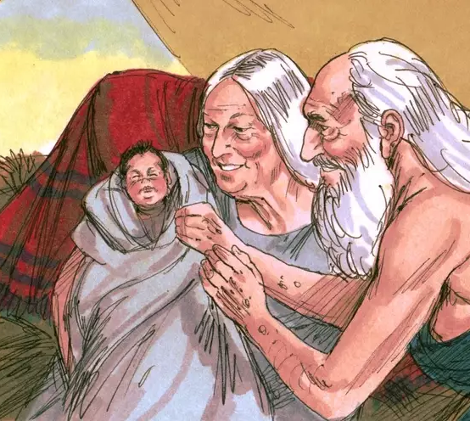
Abraham praised God even before Isaac was born.

Slide 16
Abraham praised God even before Isaac was born.
Are we willing to trust God the way Abraham did?
Can we believe in His promise even when we can’t see it?

Slide 17
Proverbs 18:21:
The tongue has the power of life and death.
Speak Life

Slide 19
“God has not given me a spirit of fear, but of power, love, and a sound mind.”

Slide 20
“God has not given me a spirit of fear, but of power, love, and a sound mind.”
“My God is able to do immeasurably more than all I ask or imagine.”

Slide 21
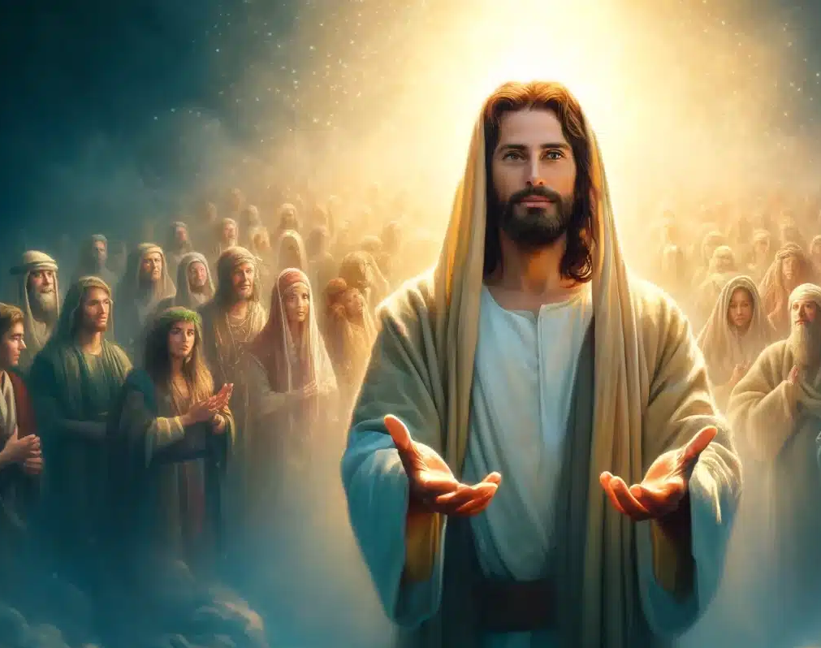
Jesus: The Fulfilment of God’s Power

Slide 24
Faith in the God of Romans 4:17
Romans 4:17: As it is written: “I have made you a father of many nations.” He is our father in the sight of God, in whom he believed—the God who gives life to the dead and calls into being things that were not.

Slide 25
Faith in the God of Romans 4:17
1. Our God gives life to the dead.
2. Our God calls into being things that do not exist.
3. Faith is trusting Him to do the impossible.
Romans 4:17: As it is written: “I have made you a father of many nations.” He is our father in the sight of God, in whom he believed—the God who gives life to the dead and calls into being things that were not.

Slide 26
Call to Action:

Slide 27
Call to Action:
What situation in your life needs God’s touch?

Slide 28
Call to Action:
What situation in your life needs God’s touch?
What promise are you waiting on?

Slide 29
Call to Action:
What situation in your life needs God’s touch?
What promise are you waiting on?
I challenge you today to trust Him completely.
Speak life over your circumstances.

Slide 30
Call to Action:
What situation in your life needs God’s touch?
What promise are you waiting on?
I challenge you today to trust Him completely.
Speak life over your circumstances.
Declare His promises, even when you can’t see the outcome.

